Slide 1

CSE205
Data Structures
Lecture #0
The kick start session

Slide 2
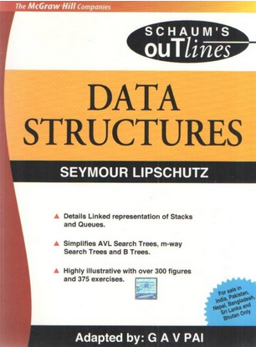
Course details
CSE205
LTP – 3 0 2 [3 lectures, 2 practicals /week]
Book to Follow
Data Structures (Schaums' Outlines Series)
Author - Seymour Lipschutz

Slide 3
Course Orientation – CSE205
COMPETITIVE EXAMINATION (Higher Education) KNOWLEDGE ENHANCEMENT PLACEMENT EXAMINATION(Mass Recruiters)

Slide 4
Course Assessment Model
CSE205 Marks break up*
Attendance 5
CA (Two best out of Three ATs) 25
MTT* 20
ETE 50
Total 100

Slide 5
Detail of Academic Tasks
CSE205
AT1: Online assignment Week 5
AT2: Online assignment Week 10 (After MTT)
AT3: Online assignment Week 13 (After MTT)

Slide 6

The course contents CSE205
Introduction to data structures
Computation of complexity
Arrays, Sorting & Searching
Linked List
Stack and Queues
Recursions
Trees
Hashing
Graphs

Slide 7


Slide 8

The hitch…
The BURNING questions in mind…
Why are we learning data structures?
What will be the course outcome?

Slide 9
What will be the course outcome?
Course Outcomes: Through this course students should be able to
CO1 :: design, implement and study various data structure algorithms.
CO2 :: understand the importance of data structures in context of writing efficient programs.
CO3 :: develop skills to apply appropriate data structures in problem solving.
CO4 :: formulate new solutions for programming problems or improve existing code using learned algorithms and data structures.

Slide 10
Why are we learning data structures?
Helps us to
  get an idea of running time of algorithm
  implement efficient algorithms
  decide on hardware requirements
  decide What is feasible vs. What is impossible
  prepare job interviews

Slide 11

Next Class: Basic Data Structures

